Slide 1


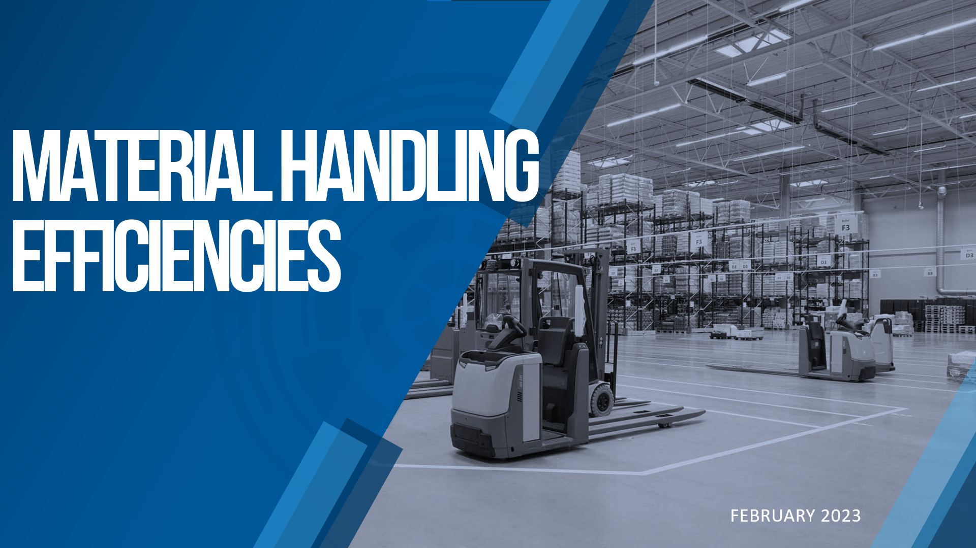

MATERIAL HANDLING EFFICIENCIES
FEBRUARY 2023

Slide 2
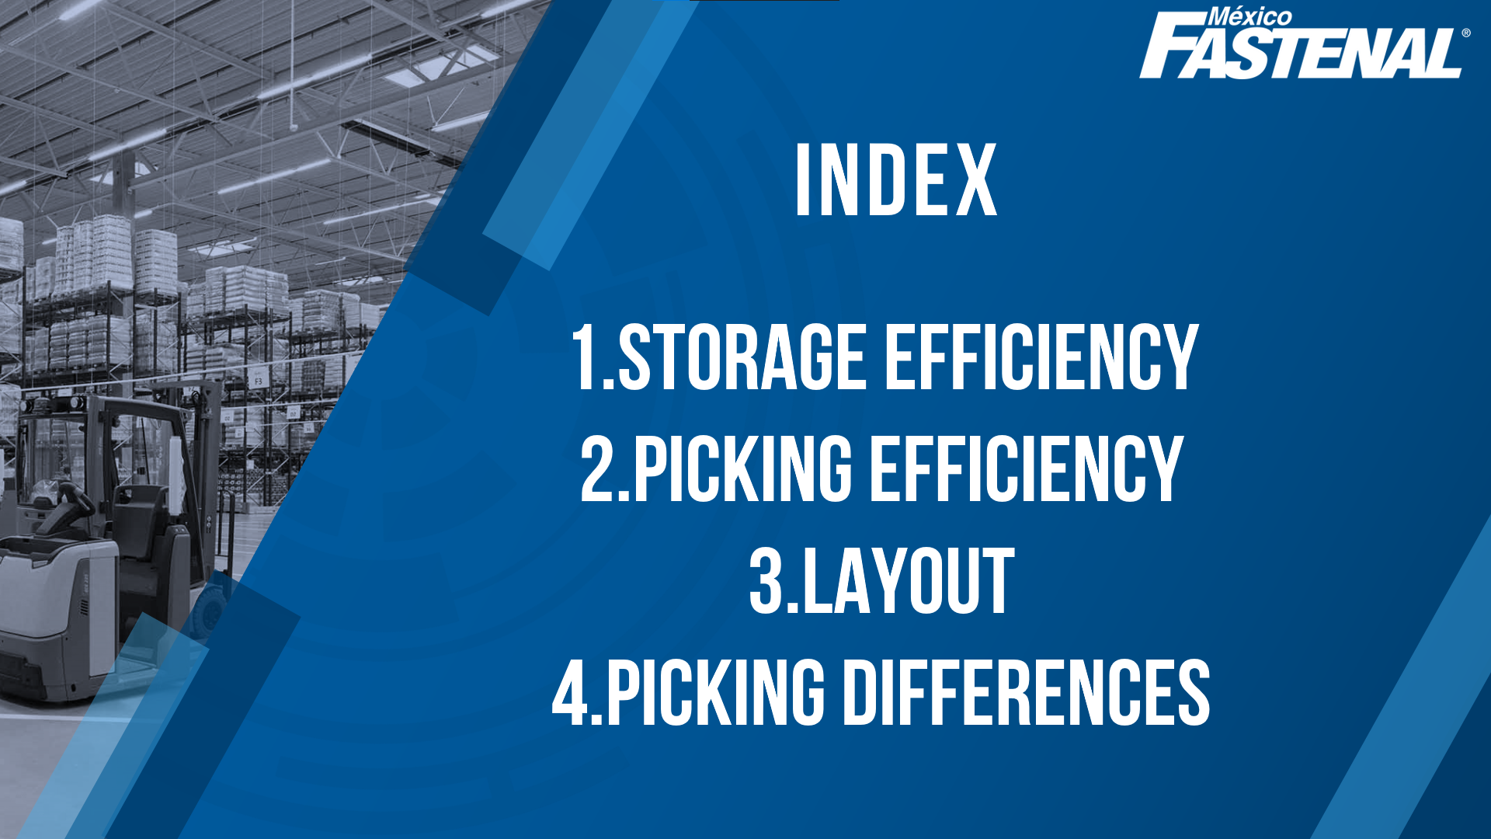


INDEX
Storage Efficiency
Picking Efficiency
Layout
Picking Differences

Slide 3

Storage Efficiency

Slide 4
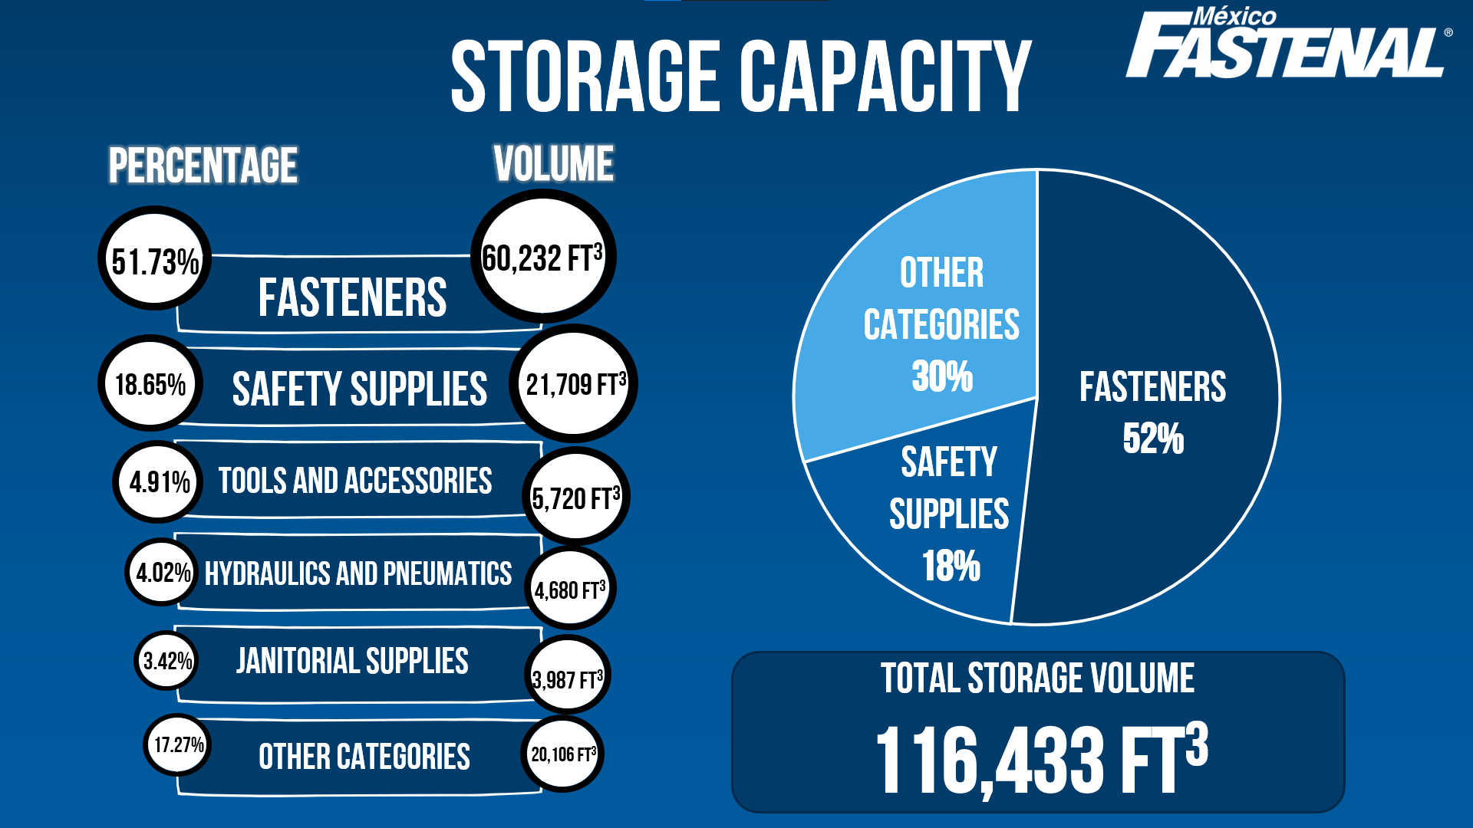
Storage Capacity
PERCENTAGE
VOLUME
51.73%
60,232 ft³
FASTENERS
OTHER CATEGORIES
30%
18.65%
SAFETY SUPPLIES
21,709 ft³
FASTENERS
52%
TOOLS AND ACCESSORIES
SAFETY SUPPLIES
18%
4.91%
5,720 ft³
4.02%
HYDRAULICS AND PNEUMATICS
4,680 ft³
3.42%
JANITORIAL SUPPLIES
3,987 ft³
Total storage volume
116,433 ft³
17.27%
OTHER CATEGORIES
20,106 ft³

Slide 5
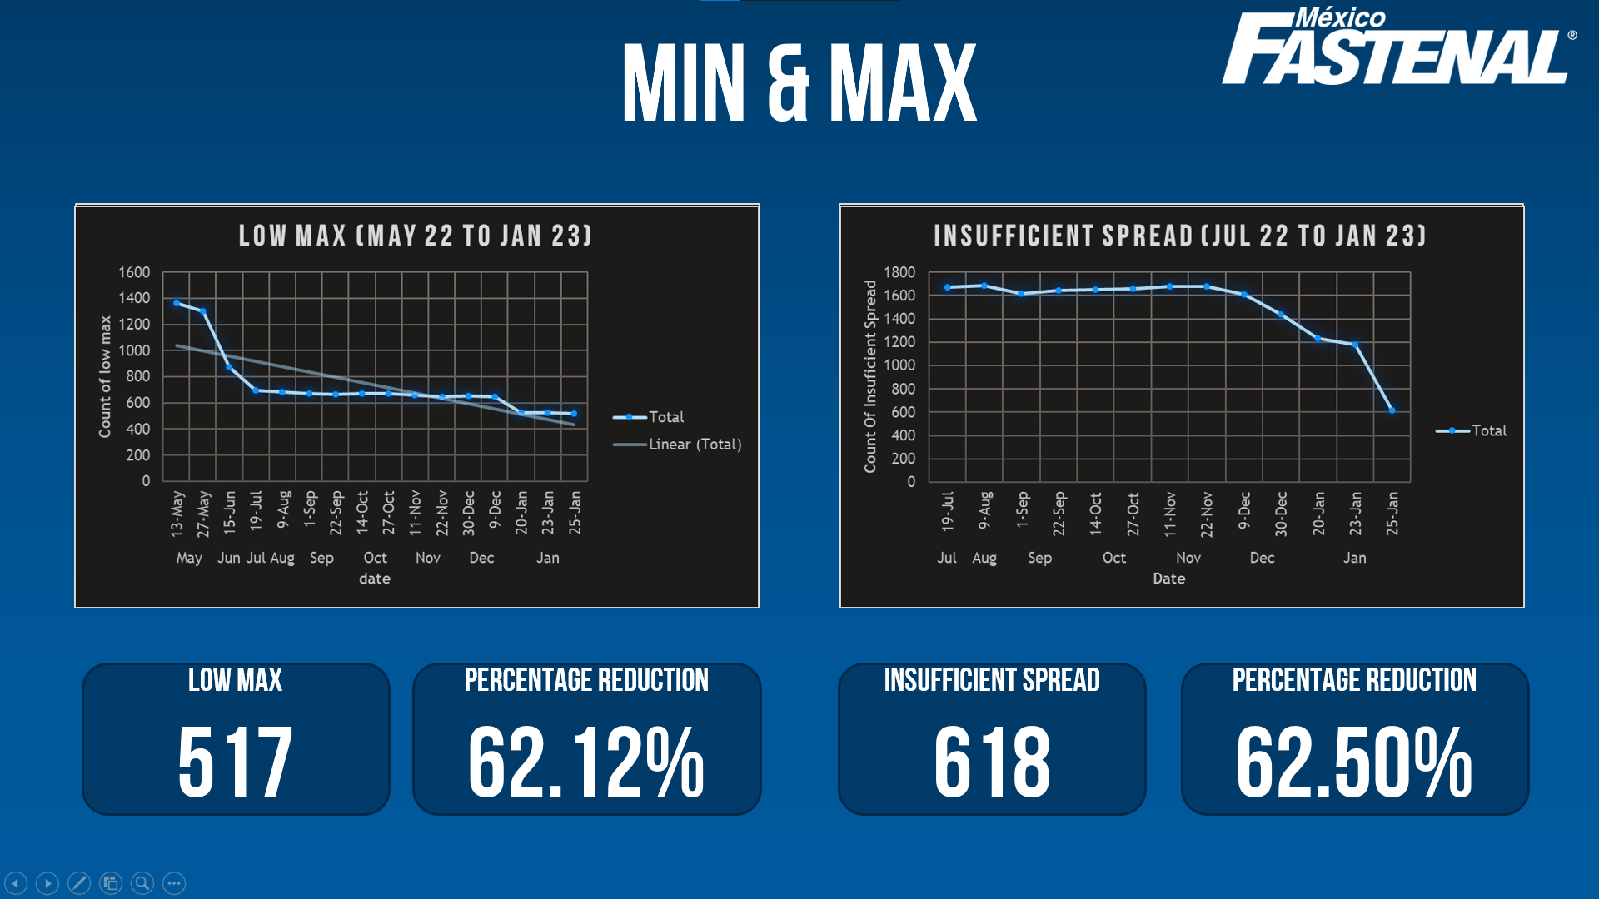
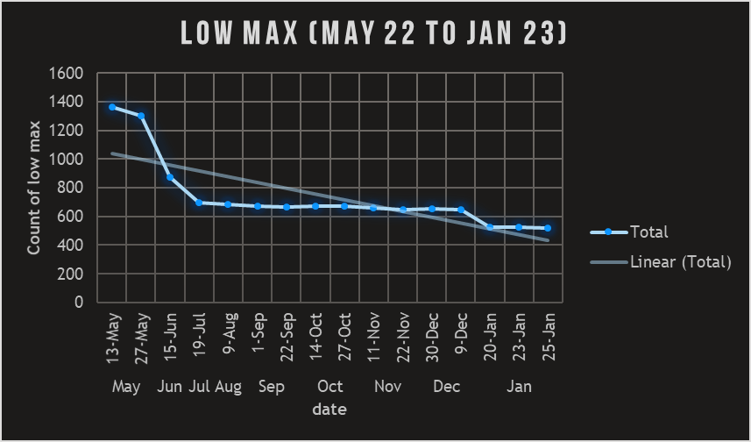
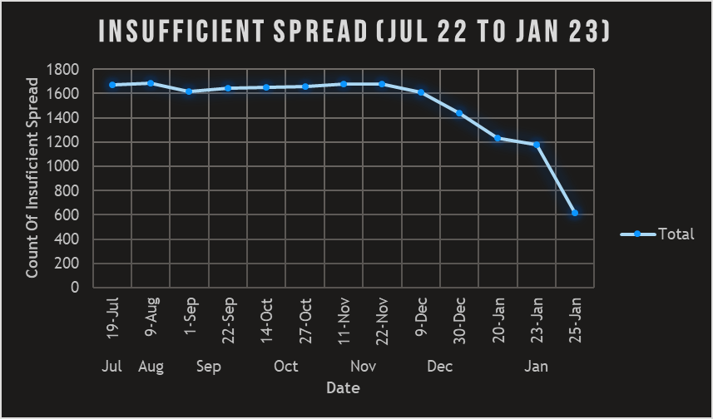
MIN & MAX
Low Max
517
percentage reduction
62.12%
Insufficient Spread
618
percentage reduction
62.50%

Slide 6
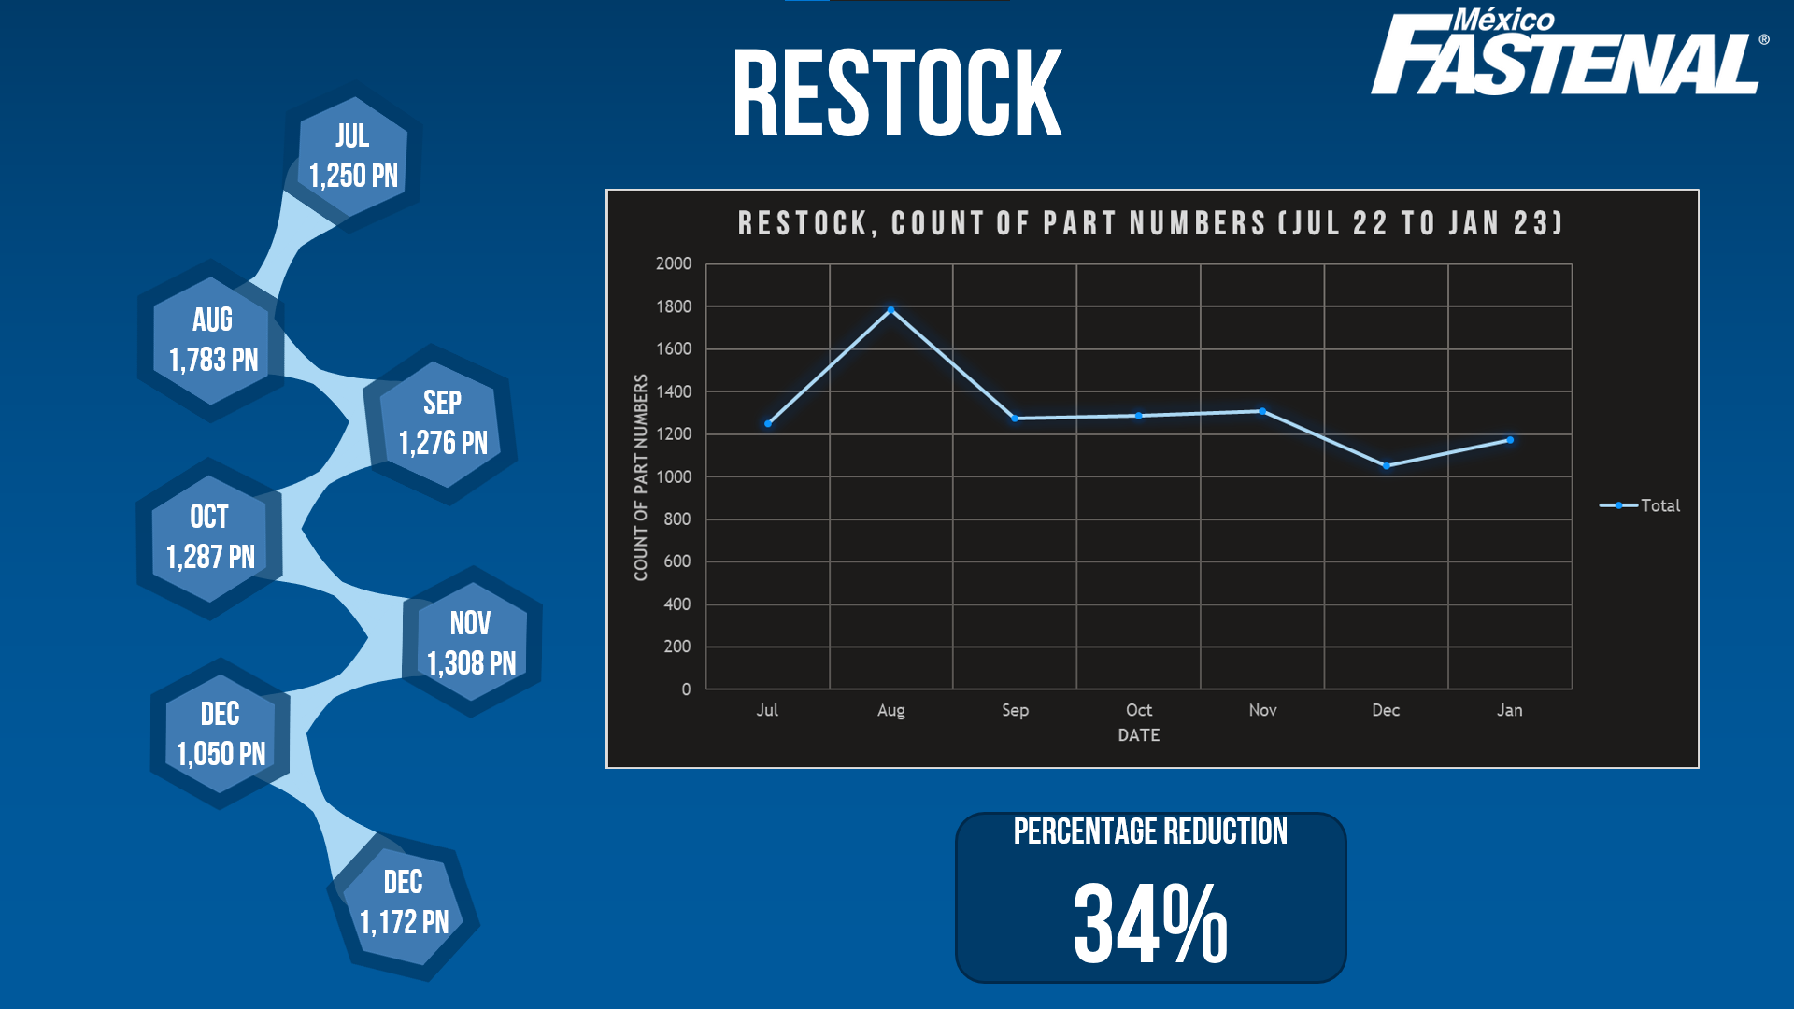



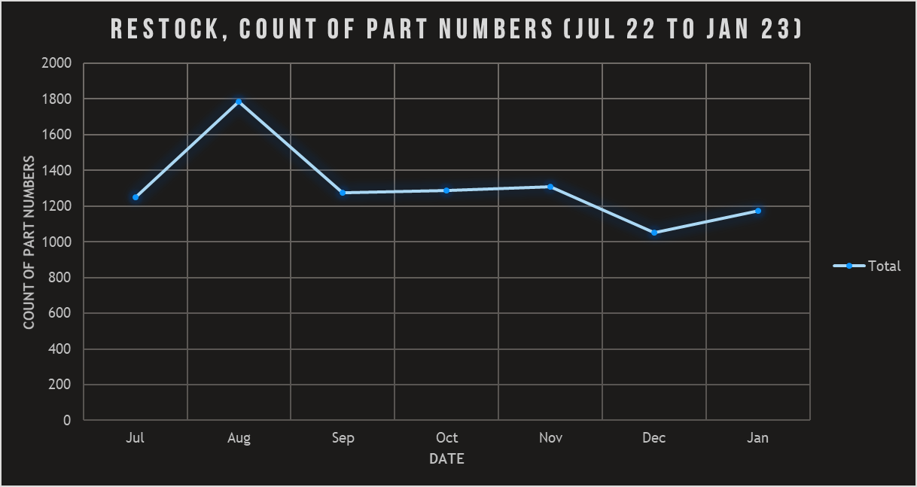
restock
JUL
1,250 PN
AUG
1,783 PN
SEP
1,276 PN
OCT
1,287 PN
NOV
1,308 PN
DEC
1,050 PN
percentage reduction
34%
DEC
1,172 PN

Slide 7
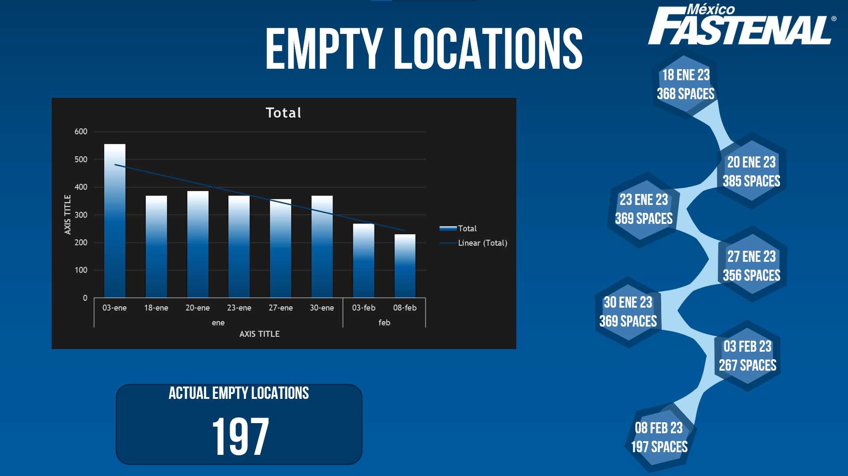
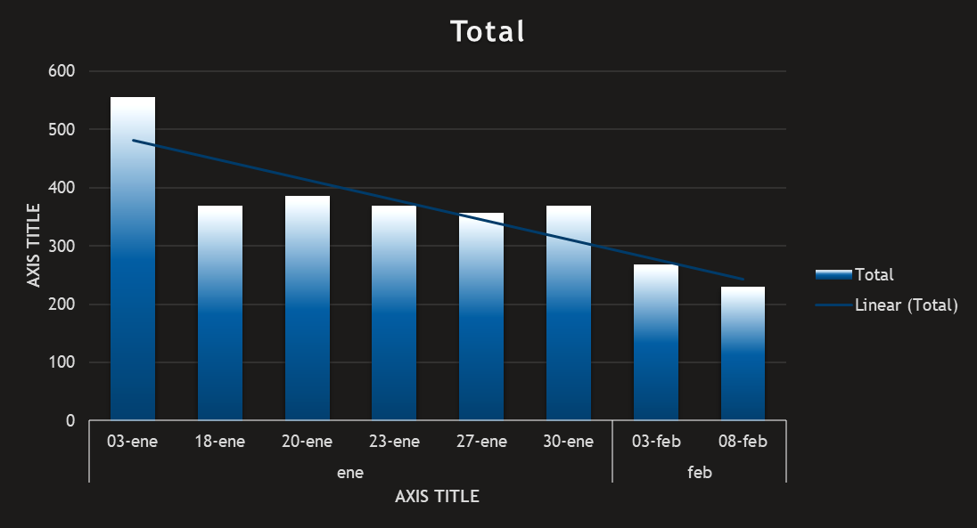
Empty locations
18 Ene 23
368 spaces
20 Ene 23
385 spaces
23 Ene 23
369 spaces
27 Ene 23
356 spaces
30 Ene 23
369 spaces
03 feb 23
267 spaces
Actual empty locations
197
08 feb 23
197 spaces

Slide 8

2.Picking Efficiency

Slide 9
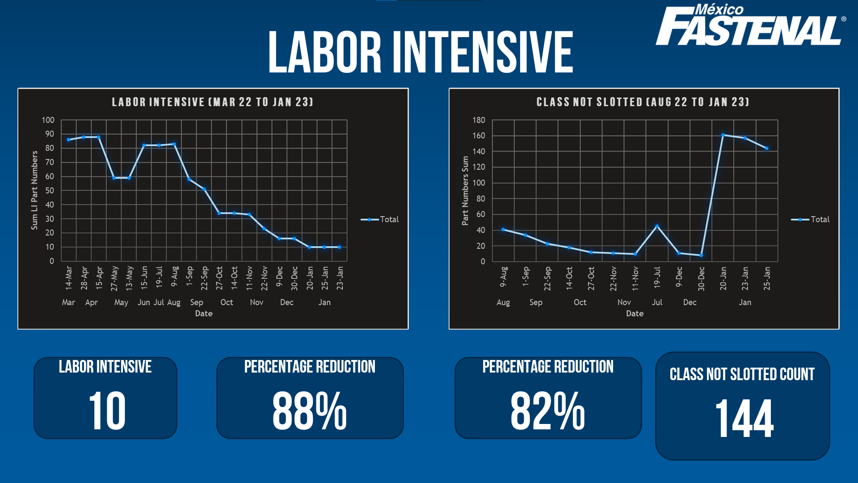
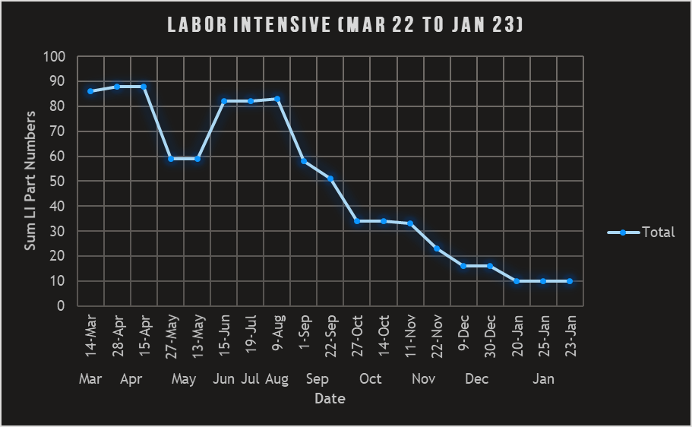
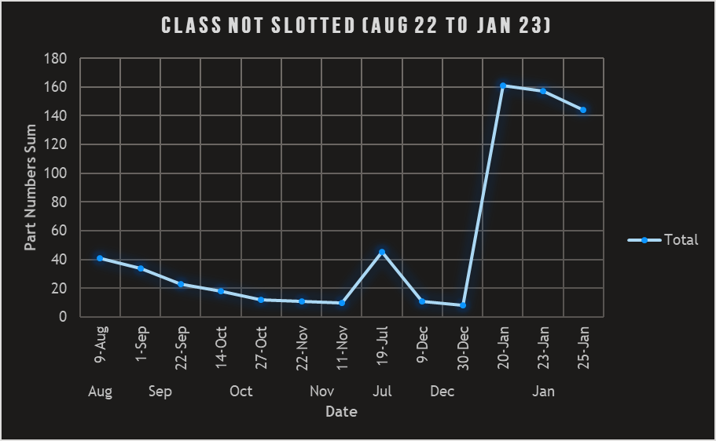
Labor intensive
Labor Intensive
10
percentage reduction
88%
percentage reduction
82%
Class not slotted count
144

Slide 10

3.Layout

Slide 11
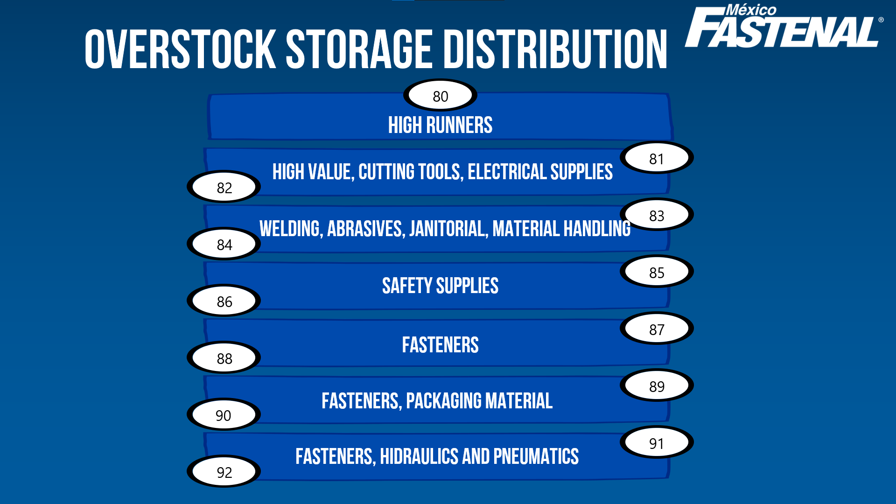
OVERSTOCK STORAGE DISTRIBUTION
80
HIGH RUNNERS
81
HIGH VALUE, CUTTING TOOLS, ELECTRICAL SUPPLIES
82
83
WELDING, ABRASIVES, JANITORIAL, MATERIAL HANDLING
84
SAFETY SUPPLIES
85
86
FASTENERS
87
88
89
FASTENERS, PACKAGING MATERIAL
90
91
FASTENERS, HIDRAULICS AND PNEUMATICS
92

Slide 12
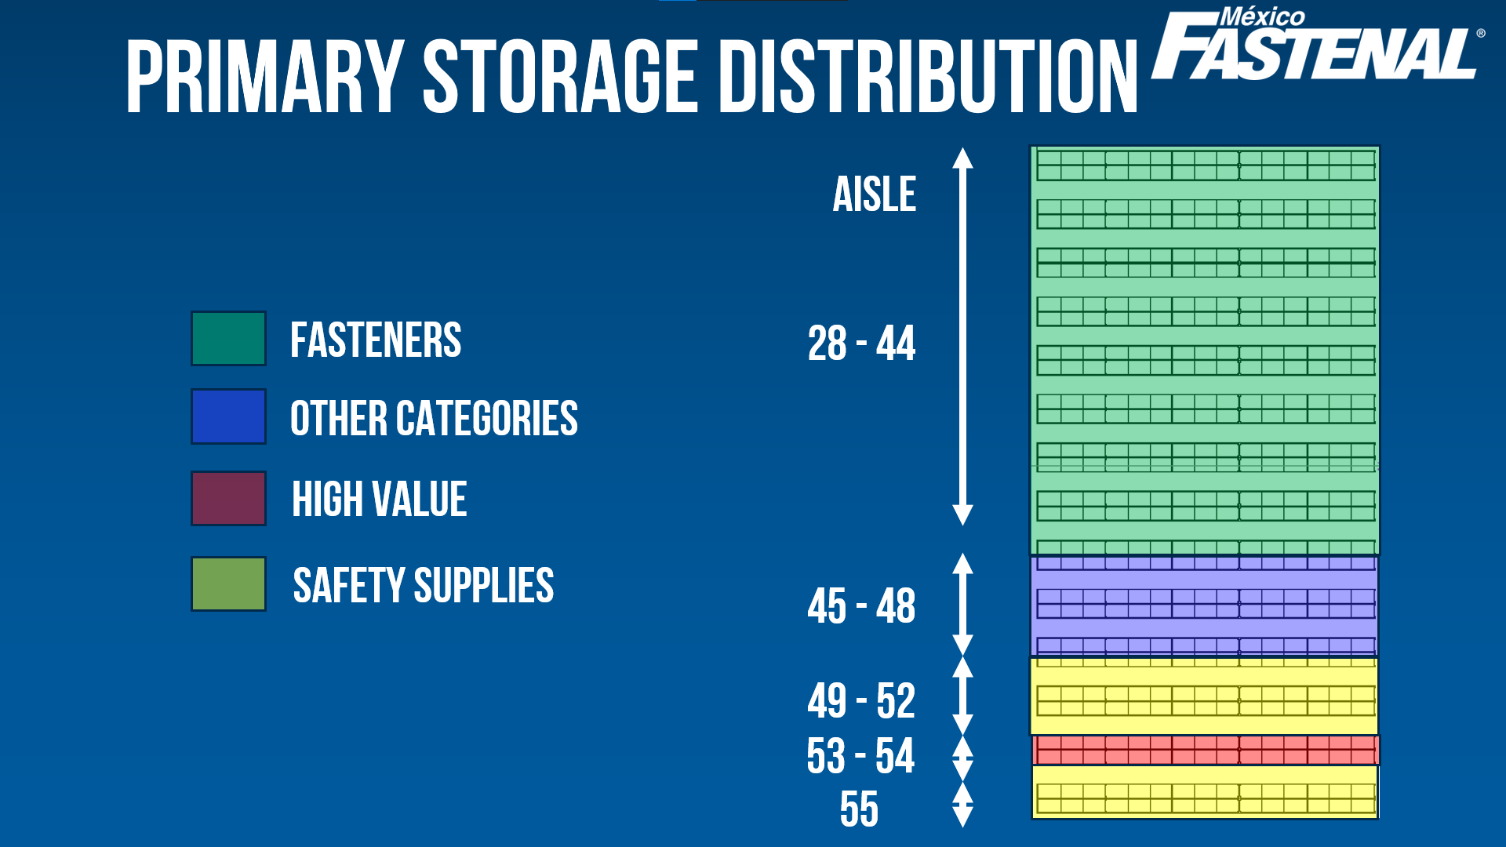
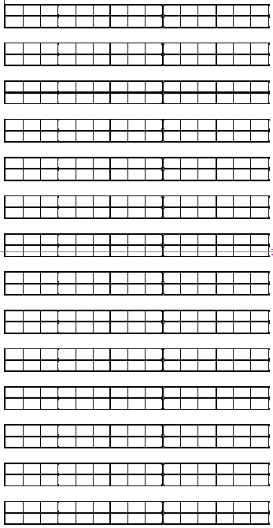
Primary STORAGE DISTRIBUTION
aisle
Fasteners
28 - 44
Other Categories
High Value
Safety Supplies
45 - 48
49 - 52
53 - 54
55

Slide 13
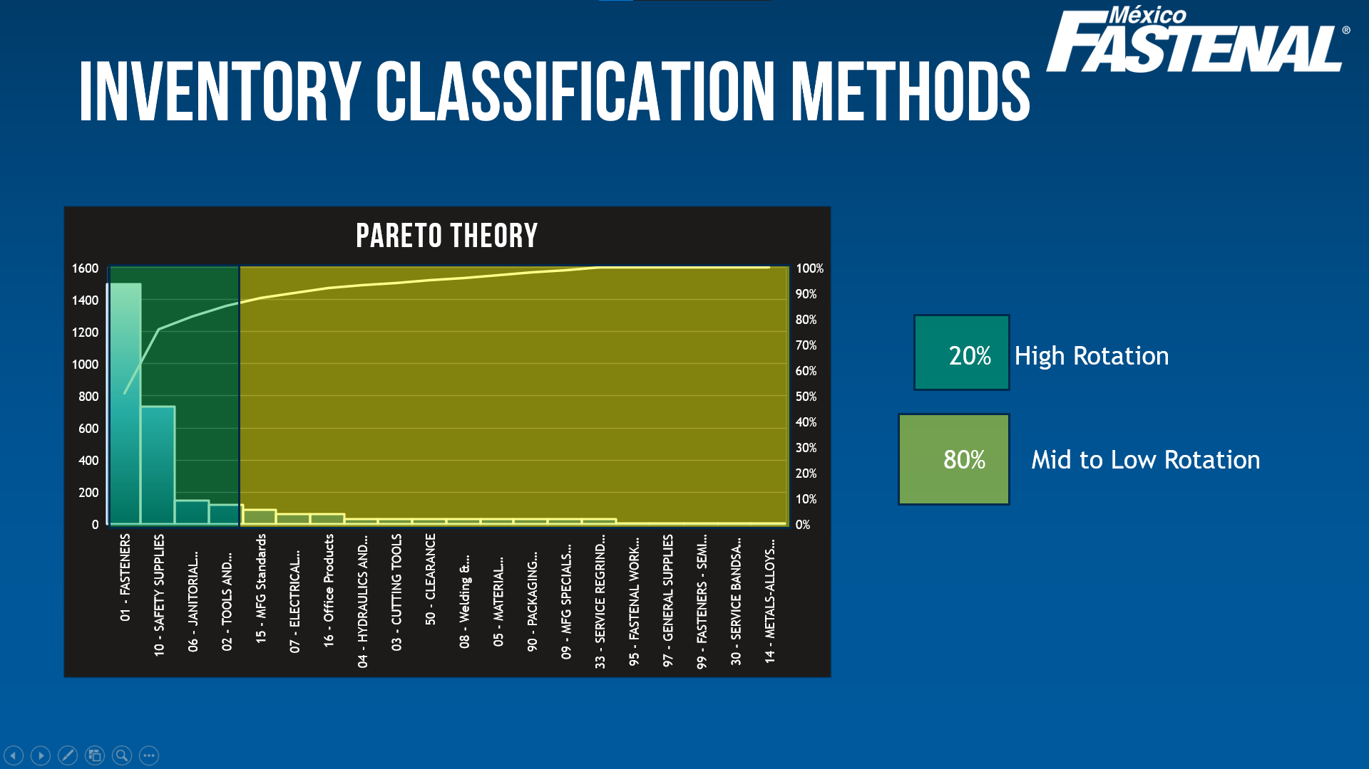
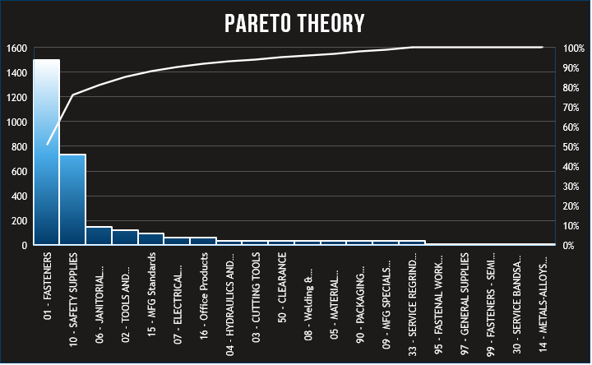
inventory classification methods
20% High Rotation
80% Mid to Low Rotation

Slide 14
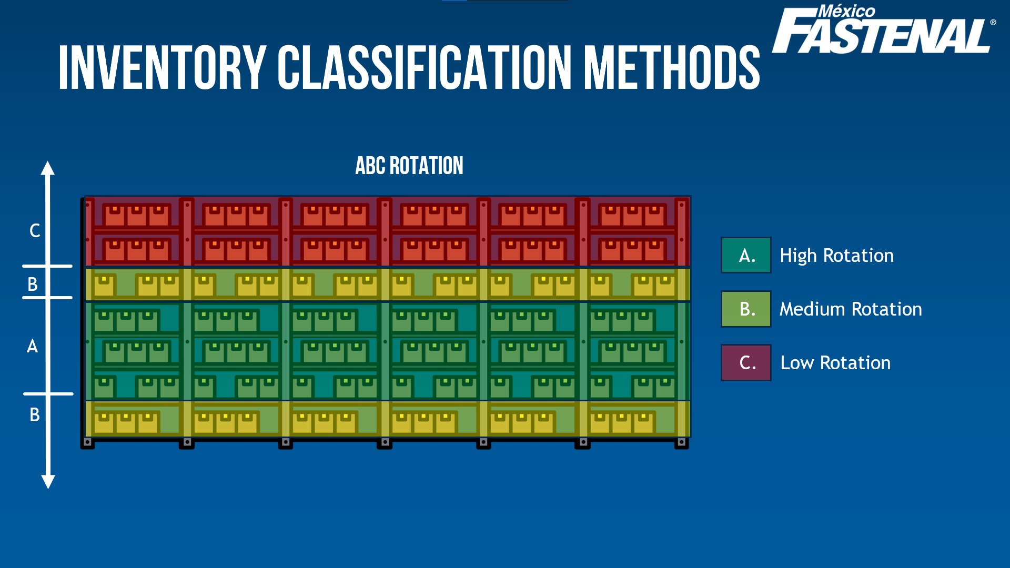

inventory classification methods
ABC Rotation
C
A. High Rotation
B
B. Medium Rotation
A
C. Low Rotation
B

Slide 15
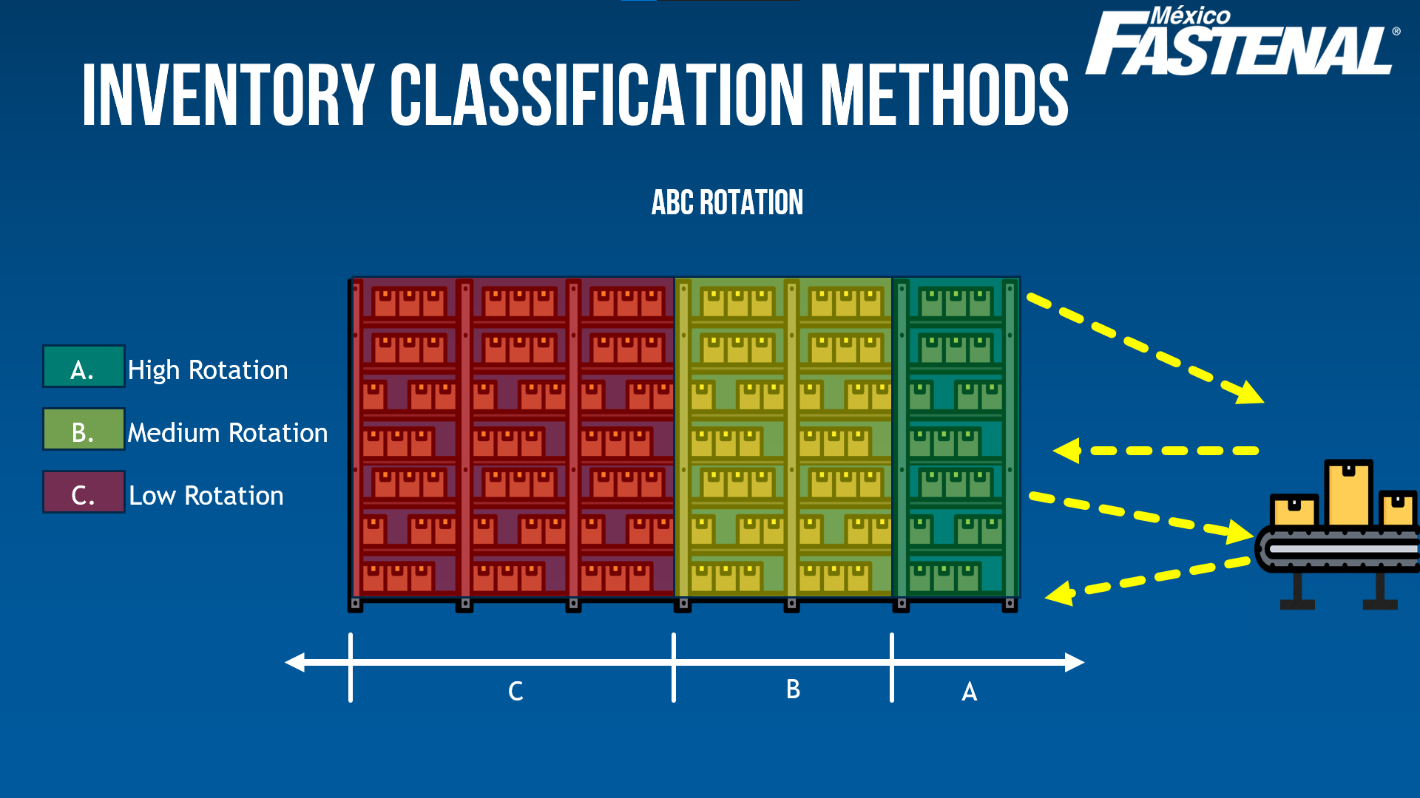


inventory classification methods
ABC Rotation
A. High Rotation
B. Medium Rotation
C. Low Rotation
C
B
A

Slide 16

4.Picking Differences

Slide 17






Picking Differences FEb 22 – FEB 23
Loc type
OR/OT/OZ
-91.54%
Loc type
HAZMAT
97.06%
Loc type
OVERSTOCK
-59.96.%
Loc type
Picking Increase
9.47%
Loc type
Floor PICK
95.24%
Loc type
Local Vendors
36.10%
Loc type
Small PArts
16.57%

Slide 18

Material Handling
Eliuth Rojas
erojas@fastenal.com

